Slide 1
Online Edu. Employment (Android)
Kick-Off Meeting
7 Aug. 2015

Slide 2
Kick-Off Meeting
Agenda
1. Self introduction
2. Scope of our project
3. Approach of our project
4. Communication plan

Slide 3
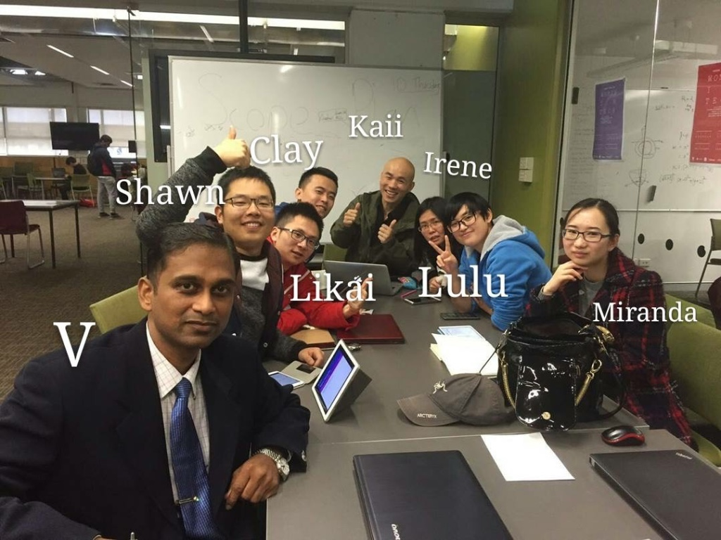
1. Self Introduction

Slide 4
2. Project Scope

Slide 5
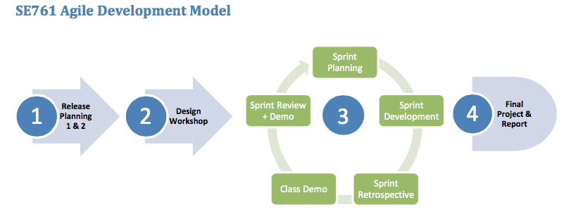
3. Project Approach

Slide 6
4. Communication Plan

